Slide 1
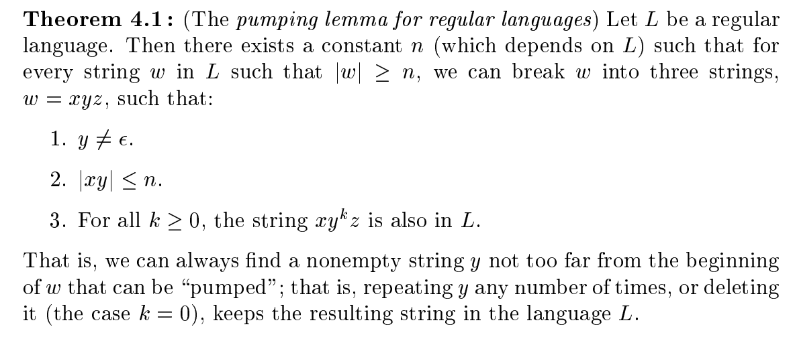
Pumping Lemma of Regular Sets (Or Regular Languages)

Slide 2
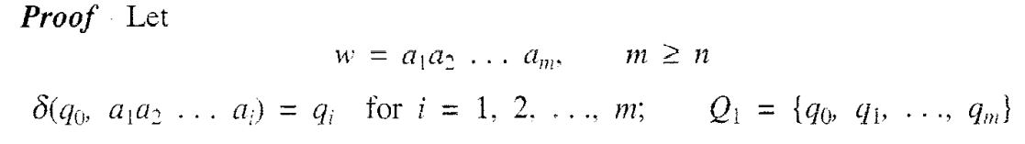
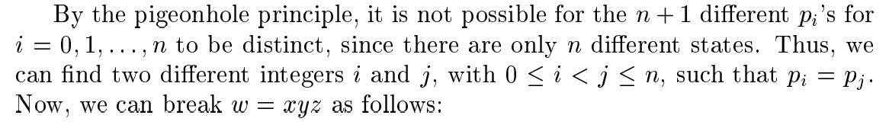
Pumping Lemma of Regular Sets (Or Regular Languages)

Slide 3
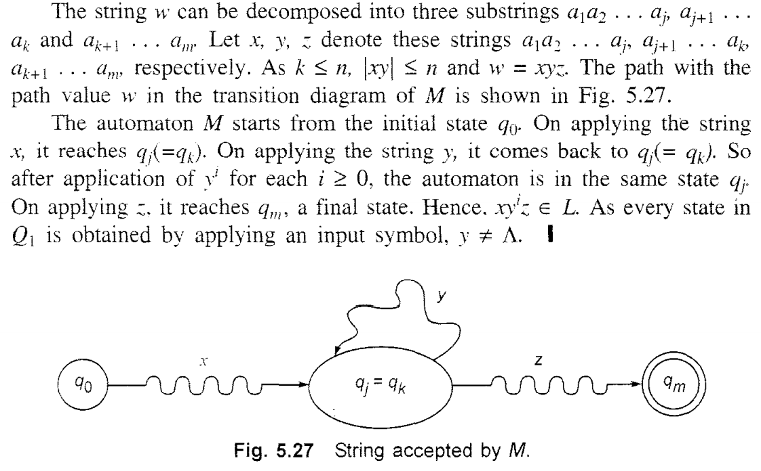
Pumping Lemma of Regular Sets (Or Regular Languages)

Slide 4
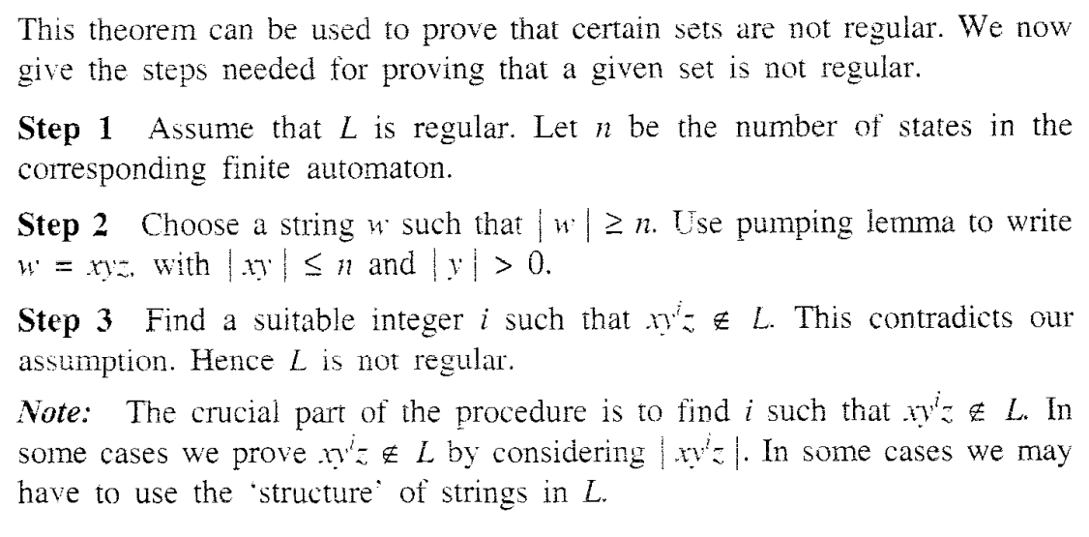
Applications of Pumping Lemma

Slide 5
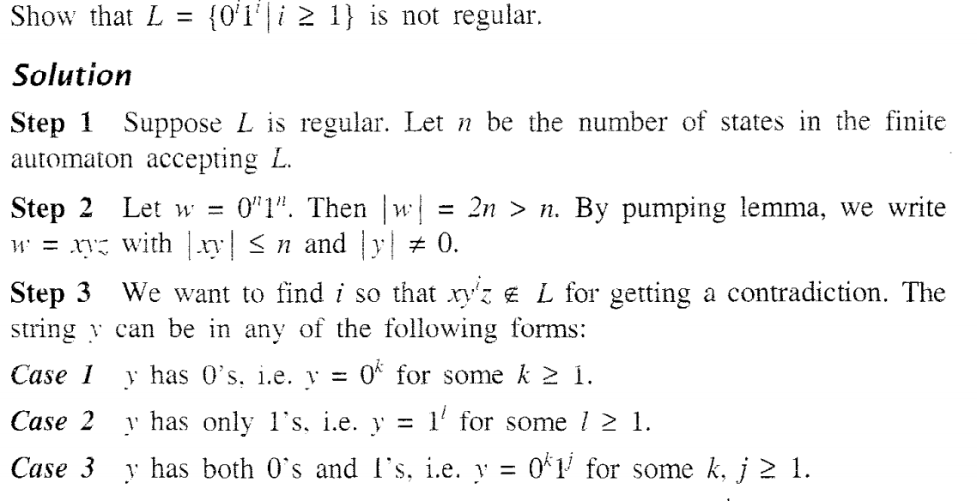
Problems

Slide 6
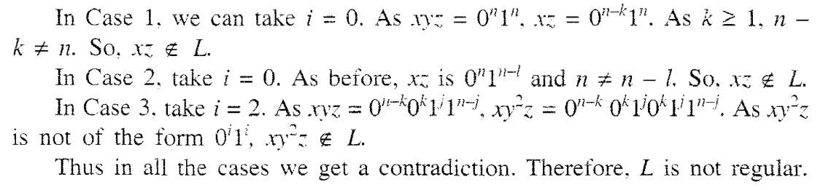
Problems

Slide 7
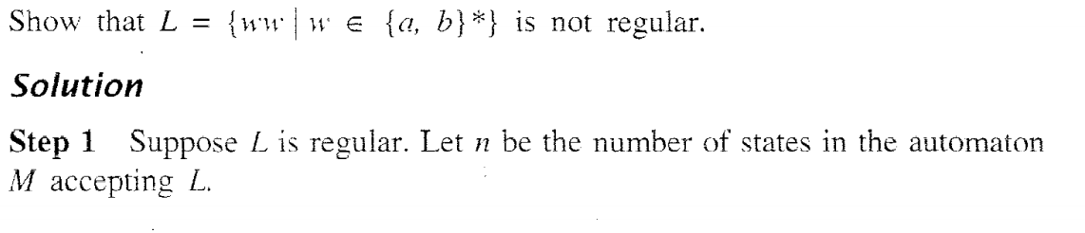
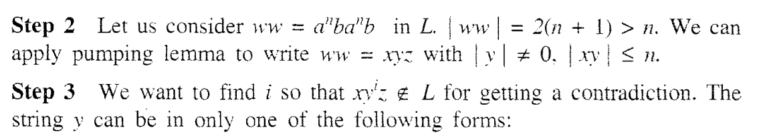
Problems

Slide 8
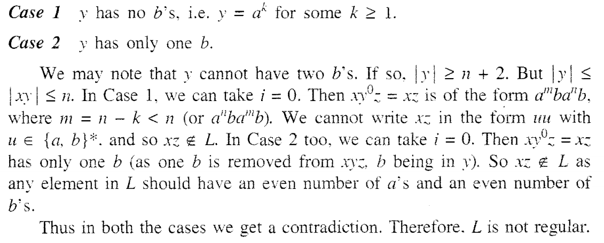
Problems

Slide 9
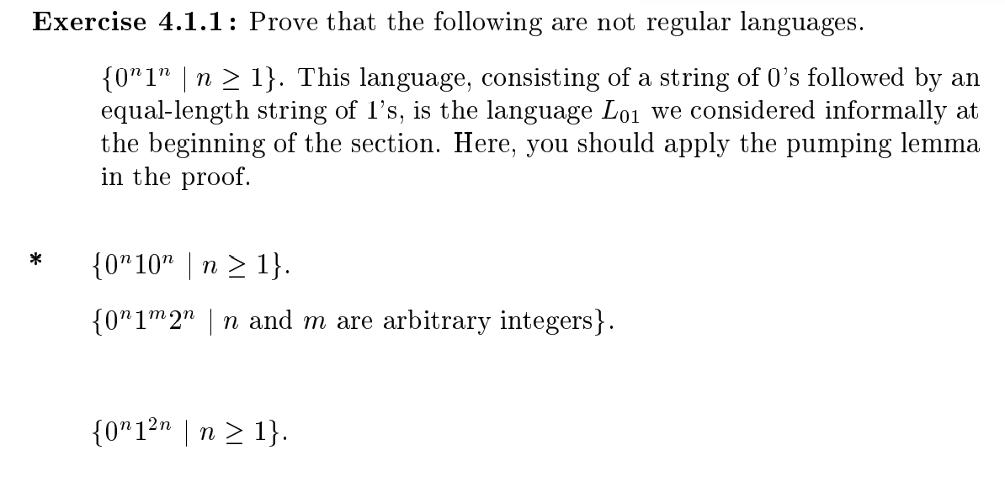
Problems

Slide 10
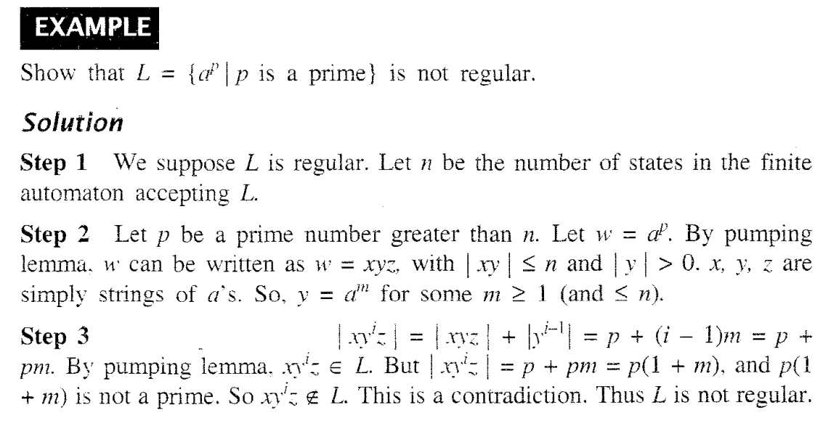
Problems

Slide 11
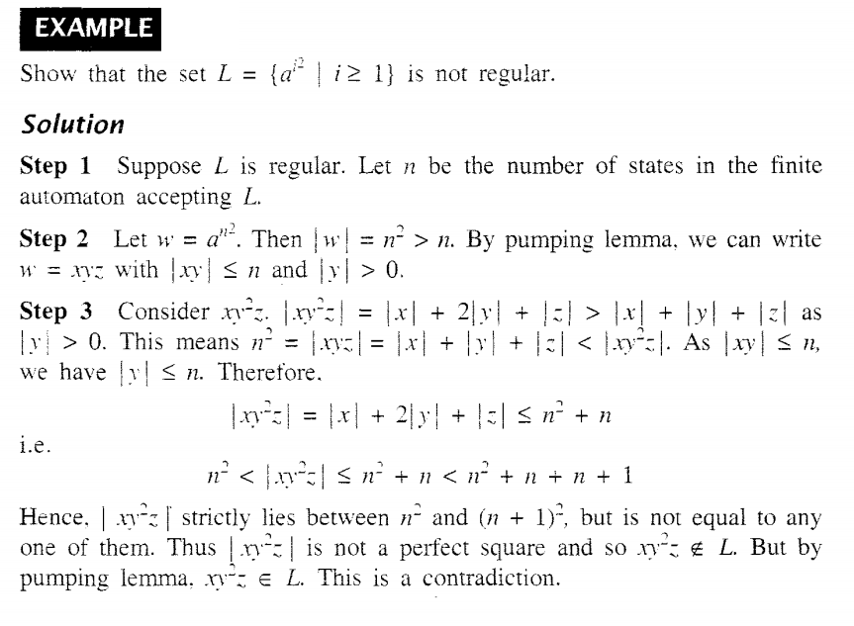
Problems

Slide 12
Unit-3 Pending Problems
Construct the finite automaton equivalent to the regular expressions
aa
a*
a+b
aa+bb
ab+ba+ca
(a+b)*
(a+b)*aa
(a+b)*aa(a+b)*
(a+b)* (aa+ba) (a+b)*
(0 + 1)*(00 + 11)(0 + 1)*
(a+b+c)*ab(a+b+c)*
Construct a finite automaton accepting all strings over {0, 1} ending in 010 or 0010
Φ
Є
a

Slide 13
Unit-3 Pending Problems
Construct the є -NFA for the regular expressions
aa
a*
a+b
aa+bb
ab+ba+ca
(a+b)*
(a+b)*aa
(a+b)*aa(a+b)*
(a+b)* (aa+ba) (a+b)*
(0 + 1)*(00 + 11)(0 + 1)*
(a+b+c)*ab(a+b+c)*

Slide 14
Unit-3 Pending Problems
Find Regular Expressions for the following Langauges
the set of all strings of 0's and 1's ending in 00
the set of all strings of 0's and 1’s, in which number of 0’s followed by number of 1’s
Number of a’s followed by number of b’s and followed by number of c’s over the alphabet {a,b,c}
The of set of all string ending in either 01 or 10
The set of all strings have the substrings either 110 or 011
Find a regular expression corresponding to each of the following subsets of {a. b}. (a) The set of all strings containing exactly two a’s.
(b) The set of all strings containing at least 2a’s.
(c) The set of all strings containing at most 2a’s.
(d) The set of a]] strings containing the substring aa
7. Any string of a’s and b’s
8. Find a regular expression consisting of all strings over {a, b} starting with any number of a's, followed by one or more b's, followed by one or more a's, followed by a single b, followed by any number of a's, followed by band ending in any string of a's and b's

Slide 15
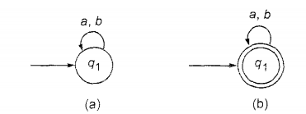
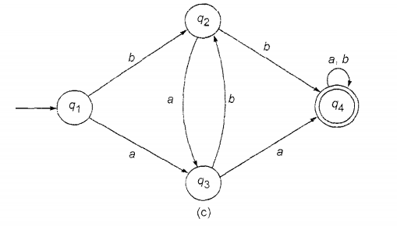
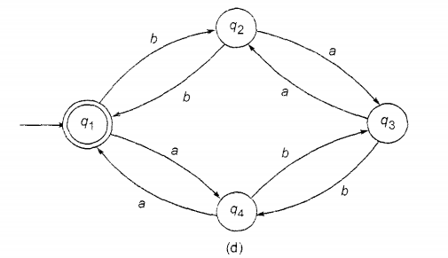
Unit-3 Pending Problems
Find the regular expression for the following finite automata and set of strings

Slide 16
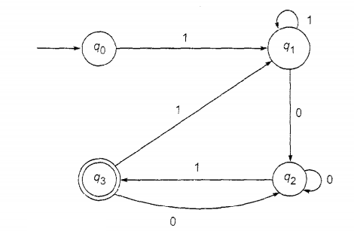
Unit-3 Pending Problems
Find the regular expression for the following finite automata

